Slide 1
HPS Test Run Contingency Plan
S. Stepanyan
JLAB

Slide 2
The test run goals – validate critical experimental assumptions made in the proposal for occupancies and trigger rates
Measure occupancies and rates in Si-tracker layers and in the ECal, and measure trigger rates with close-to-final beam/target/detector configuration, and demonstrate feasibility of running experiment at the proposed luminosities
But before measuring occupancies and rates we need to have
  compact ECal and ECal DAQ system [based on JLAB FADC]
  high rate ECal trigger system
  Si-tracker operational in vacuum
  integrated SLAC (Si-tracker) and JLAB (ECal, trigger) DAQ systems
  fast data readout and data monitoring
all these can be configured and tested using photon beam in Hall-B and the Hall-B pair spectrometer, in a non-invasive manner for the running experiment on CLAS

Slide 3
November (2011) –May (2012) running in Hall-B
Photoproduction experiment on polarized HD target (HDice/g14) using tagged bremsstrahlung photon beam
Beam energies from 2.2 GeV to 5.5 GeV
Bremsstrahlung photon beam is produced on the radiator ~28 meters upstream of the CLAS target
During photoproduction experiments pair production on a thin high-Z target, installed on the photon beam ~18 meters upstream of the CLAS target, is used to monitor tagger focal plane performance
Produced lepton pairs, after passing through magnetic field of the pair spectrometer dipole magnet, get detected with scintillator hodoscopes

Slide 4
CLAS and HDice target
Pair spectrometer
Photon tagger

Slide 5
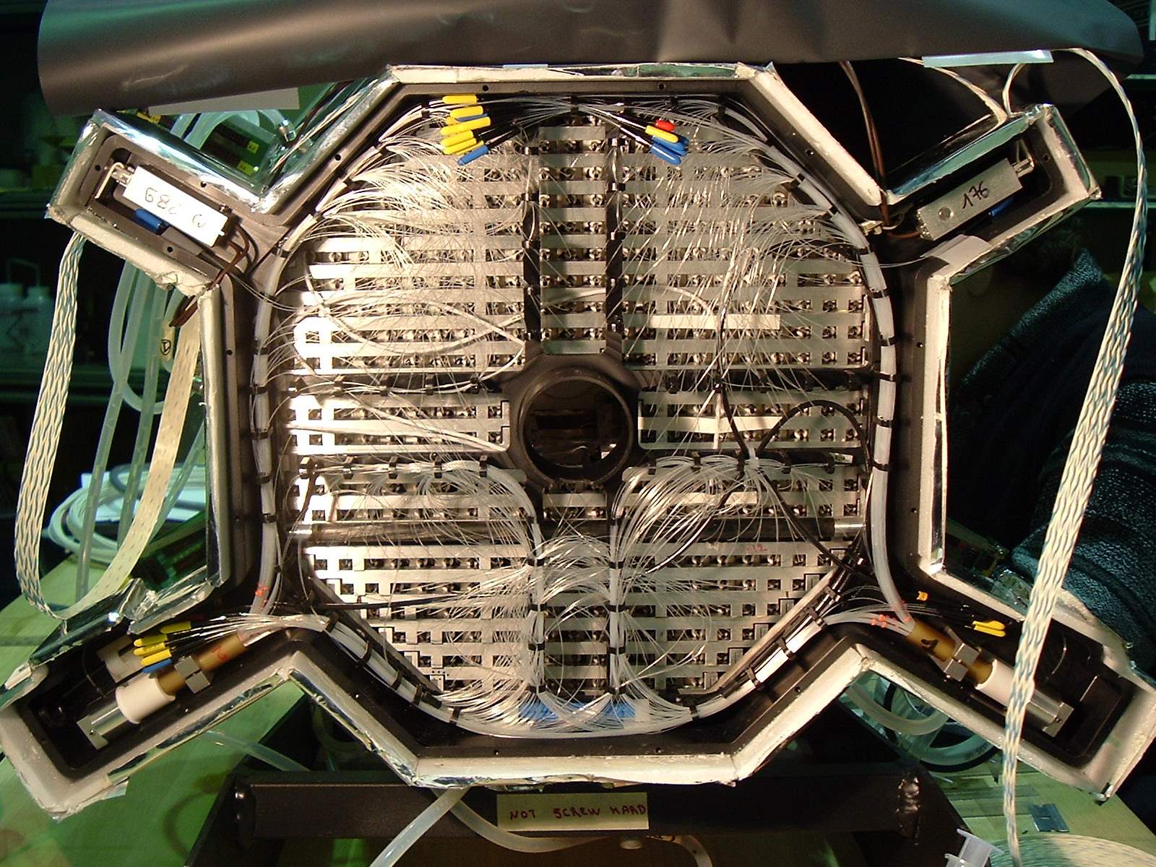
Stage-I of the parasitic running
Install CLAS/DVCS Inner calorimeter, IC, downstream of the pair spectrometer vacuum chamber window, between left and right hodoscope layers – stand is available
Photon beam will pass through the central hole of the IC, while secondaries, mostly photons and electrons will get into IC
Pair spectrometer target (typically 10⁻³ r.l. gold foil)

Slide 6
Goals and what can be accomplished
Setup and test HPS ECal front-end electronics and DAQ using JLAB FADCs
Setup and test ECal trigger system based on FADCs
Debugging of the whole system and it’s calibration will be done using 2γ decays of π⁰s (P>1.5 GeV), produced in the pair spectrometer target
High rate capability of the trigger system can be tested by
  increasing the thickness of the target (x10)
  lowering field strength of the pair spectrometer dipole
Final product - fully operational HPS ECAL DAQ and trigger system
Stage-I of the test run make sense only if JLAB FADCs and trigger boards are available and tested prior to the run

Slide 7
Stage-II of the parasitic run
Install HPS test setup detectors (Si-tracker and ECal), using machine/experiment down times during March-April of 2011
Install HPS ECal downstream of the pair spectrometer vacuum chamber, in front of the pair spectrometer hodoscopes – will need some modifications of the existing stand
Two parts of the ECal will be positioned up and down of the beam plane and will not interfere with PS operations
Install Si-tracker assembly without the target inside the pair spectrometer vacuum chamber
Will require dedicated time for installation and alignment (~2 days). Some beam line modifications upstream of the vacuum chamber will be needed to accommodate a new flange with Si-tracker feedthroughs
Tracking layers will be positioned up and down of the beam plane and will not interfere with PS operations

Slide 8
Goals and and what can be accomplished
ECal DAQ and trigger system test with the new geometrical configuration of lead-tungstate modules
If there are no FADCs and the Stage-I did not happen, ECal will be tested with CLAS/IC DAQ and trigger system
Test Si-tracker operations and DAQ
Integrate SLAC and JLAB DAQ systems
Test fast data readout and monitoring systems
Final product - fully operational HPS test apparatus, DAQ and trigger system, ready for electron run
Stage-II makes sense even without FADCs. For ECal existing CLAS/IC DAQ (gated ADCs) and trigger system (cluster finding with “single bit” energy information) can be used. This system can run up to 10kHz with ~85% life time. If running with electron beam will be come reality, somewhat reduced luminosities or pre-scaled trigger can be used to measure occupancies

